Slide 1
DEEP LEARNING
Detection Of Skin Diseases

Slide 2
The Problem
The identification of skin diseases aims to improve patients' quality of life and is of vital importance. The use of technologies such as artificial intelligence, deep learning, and image processing can enhance the diagnosis and treatment processes. In conclusion, the identification of skin diseases is an important research and service area supported by the opportunities provided by modern medicine and technology, aimed at supporting healthy living and improving accessibility and effectiveness of healthcare services for people.

Slide 3
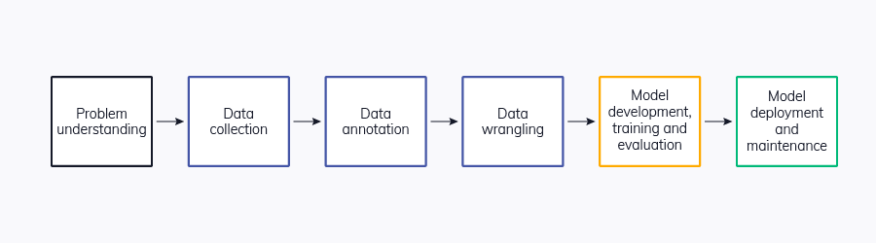
Road Map

Slide 4
Dataset
The HAM10000 dataset is specifically curated for the training of neural networks used in the automated diagnosis of skin lesions.
The dataset contains dermoscopic images obtained from different populations and various types of skin lesions. Each image's lesion is labeled with tags representing various categories of skin lesions.

Slide 5
Dataset -Labels
The labels in the dataset include:
- Actinic keratoses and intraepithelial carcinoma / Bowen's disease (akiec)
- Basal cell carcinoma (bcc)
- Benign keratosis-like lesions (solar lentigines / seborrheic keratoses and lichen-planus like keratoses, bkl)
- Dermatofibroma (df)
- Melanoma (mel)
- Melanocytic nevi (nv)
- Vascular lesions (angiomas, angiokeratomas, pyogenic granulomas and hemorrhage, vasc)

Slide 6
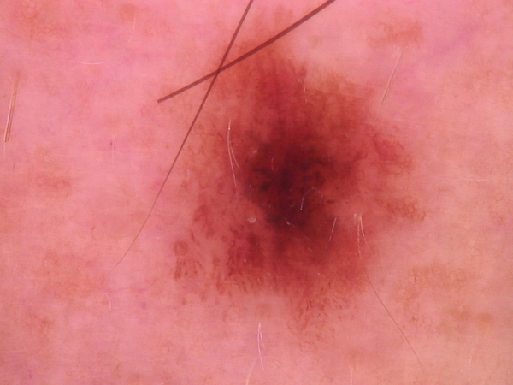
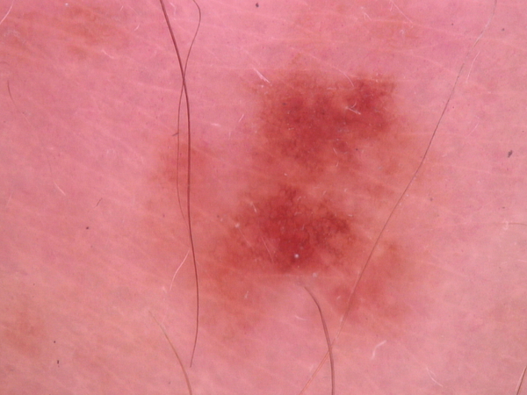
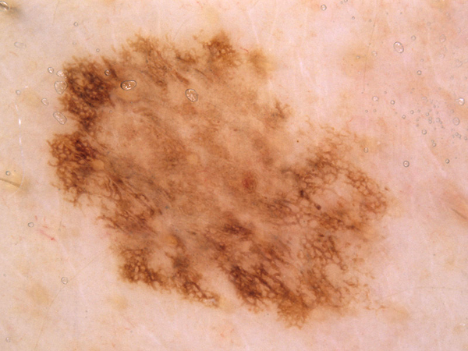
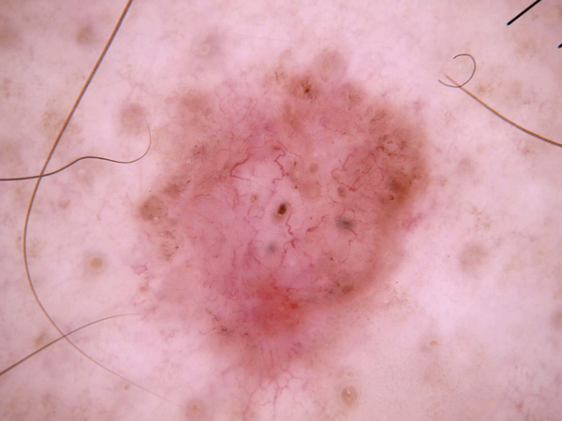
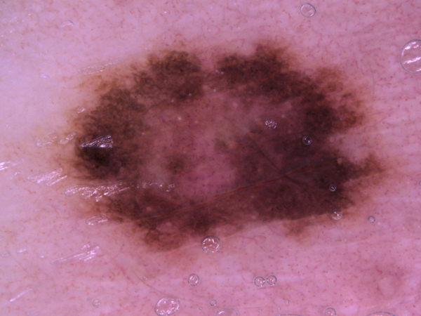
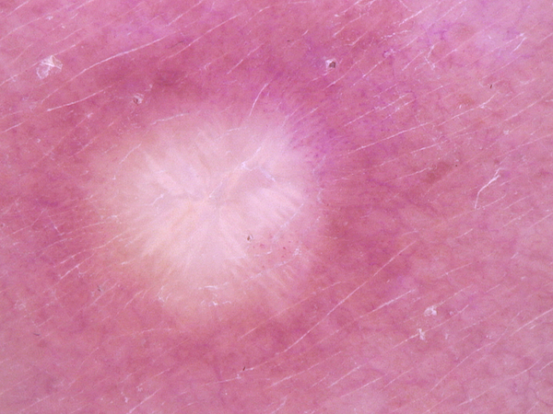
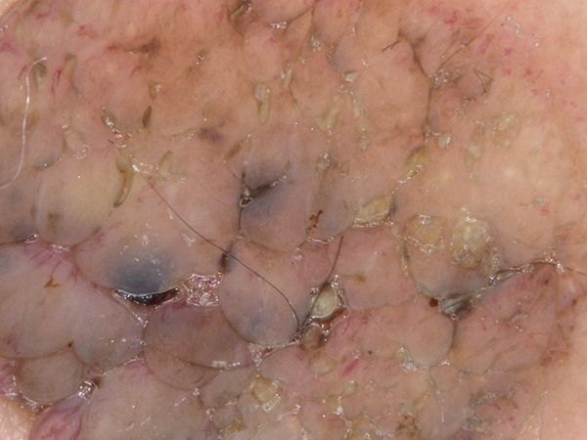
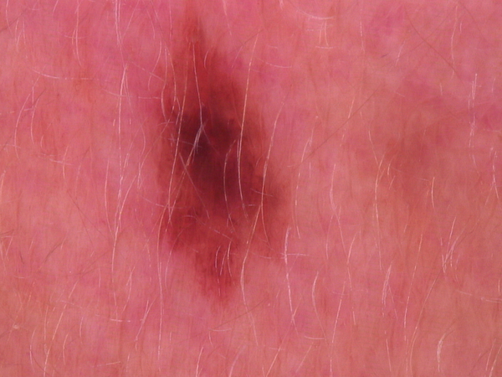
Dataset
HAM10000

Slide 7
Modal - CNN
Convolutional Neural Network (CNN) is a type of artificial neural network that is widely used in the field of deep learning and is especially successful in image processing tasks.
Convolutional layers are one of the fundamental components of a Convolutional Neural Network (CNN) and are commonly used in image processing tasks. These layers perform the movement of filters (kernels) over the input data to detect features.

Slide 8
Layers
Convolutional Layers
Activation Layers
Pooling Layers
Flattening Layer
Fully Connected Layers
Output Layer

Slide 9
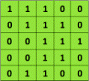


Slide 10
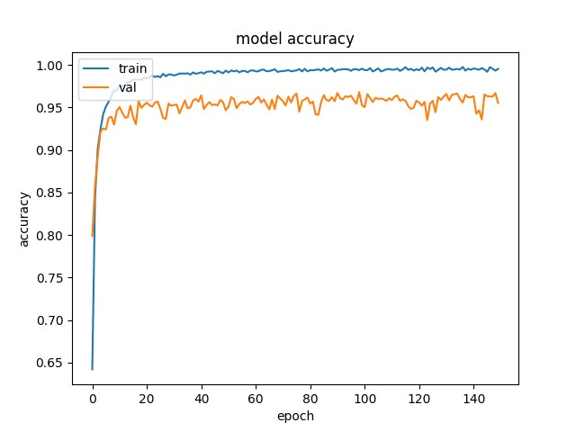
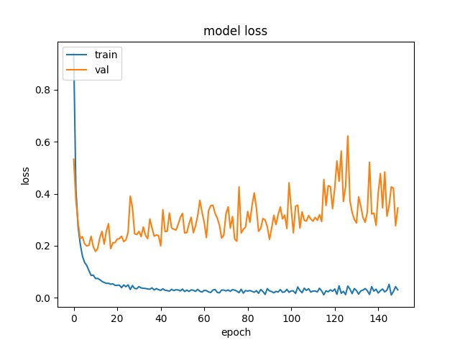
Results

Slide 11
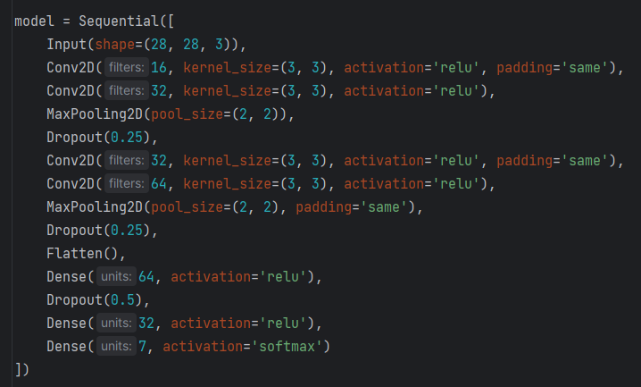
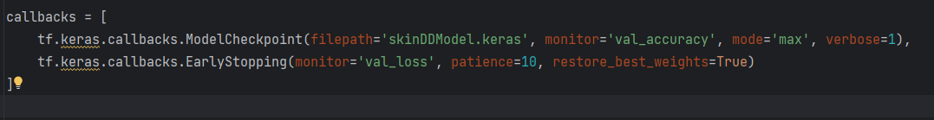

Slide 12
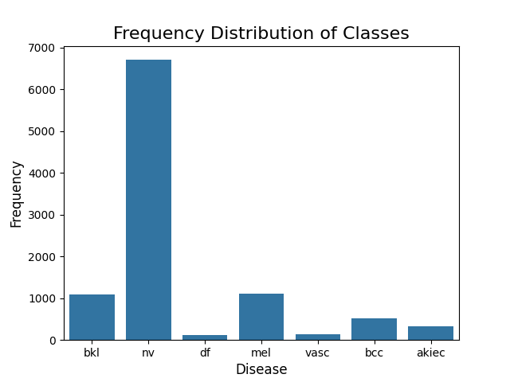
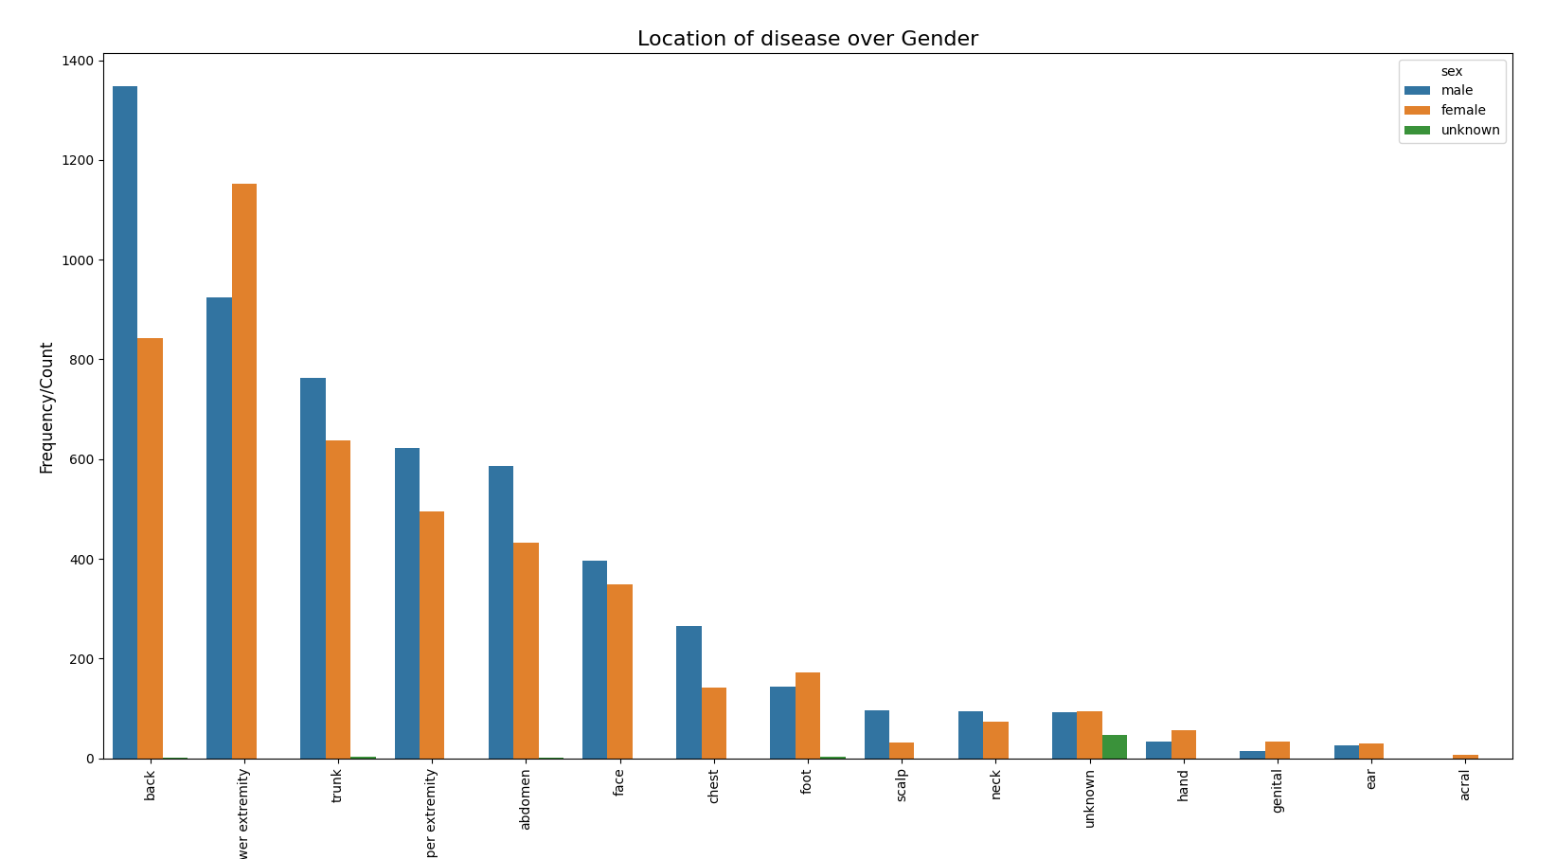
Results

Slide 13
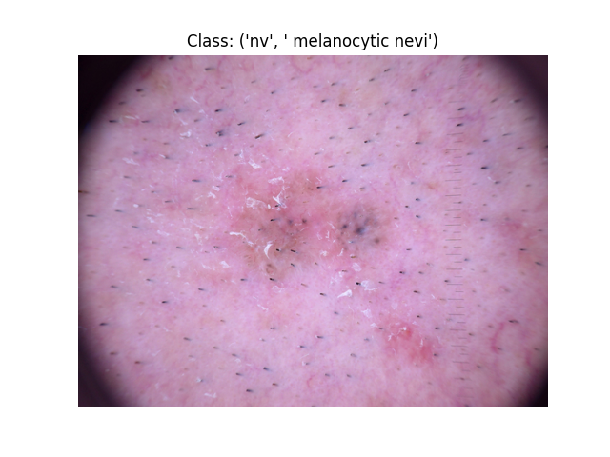
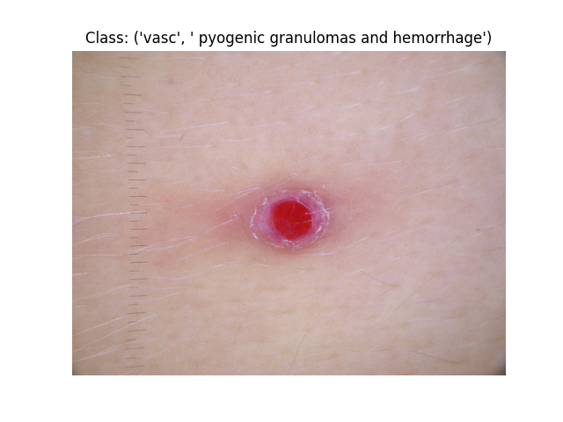
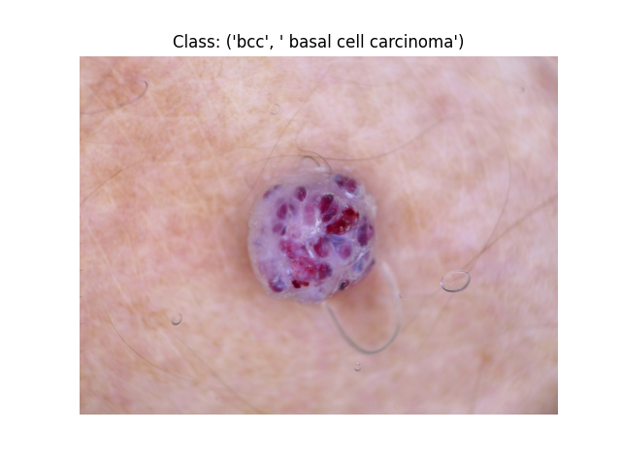
Results

